Slide 1
What is Utopia?
How do we get there?

Slide 2

My Definition of Utopia
High Individual Liberty for all humans
High Standard of Living for all humans
High Social Mobility for all humans

Slide 3
Utopian Theory

Slide 4
Why These Three Principles?
Individual Liberty: Personal freedom has often been linked to creativity, innovation, and personal fulfillment. Societies that prioritize individual liberty usually see a blossoming of arts and sciences. For example, during the Enlightenment, when there was an emphasis on individual thought and skepticism of authority, there was a significant surge in scientific discoveries and cultural development.
Social Mobility: Evidence supports that societies with higher social mobility often have lower social tensions. In countries where people feel they can change their social standing through hard work and opportunity, there is generally less resentment between different social classes. The Nordic countries, for example, have high levels of social mobility and also consistently score highly on happiness and quality of life indexes.
High Standard of Living: The link between the standard of living and well-being is well-researched. Countries with high GDP per capita, quality healthcare, and education often report higher life satisfaction. Moreover, a high standard of living is often associated with longer life expectancy and lower crime rates. Countries that focus on social welfare policies, ensuring that everyone has access to essential needs, often exhibit these positive traits.

Slide 5
Underpinning Psychological Models
Maslow's Hierarchy of Needs: A psychological theory that describes five levels of human needs, arranged in a pyramid. From bottom to top, the levels are: physiological, safety, love/belonging, esteem, and self-actualization. The lower needs must be satisfied before higher-level needs become motivating.
Choice Theory: Developed by Dr. William Glasser, Choice Theory posits that human behavior is driven by the choices made to satisfy five basic needs: survival, love/belonging, power, freedom, and fun. It emphasizes personal responsibility and the idea that the only person's behavior we can control is our own.
Self-Determination Theory (SDT): A theory of motivation that focuses on the degree to which human behavior is self-motivated and self-determined. It centers around three basic psychological needs: autonomy, competence, and relatedness. Fulfilling these needs leads to optimal development and well-being.
Roger Walsh's Therapeutic Lifestyle Changes (TLC): A set of evidence-based lifestyle therapeutic practices that aim to enhance mental health and well-being. It includes exercise, nutrition, exposure to nature, relationships, recreation, relaxation, religious/spiritual engagement, and contribution and service.

Slide 6
Distilling Universal Human Needs
Basic Needs: Includes physiological needs and safety, emphasizing survival and security.
Love and Belonging: A recurring theme that highlights connection and relationships.
Autonomy and Freedom: A focus on individual choice, control, and the ability to pursue one's path.
Growth and Self-Actualization: Concerns personal development, competence, and reaching one's potential.
Well-Being: Encompasses mental and physical health, relaxation, and overall wellness.

Slide 7
Models on Morality and Perspective
Kohlberg's Theory of Moral Development: A stage theory describing the development of moral reasoning. It consists of three levels, each with two stages: Pre-conventional (obedience, self-interest), Conventional (interpersonal accord, authority), and Post-conventional (social contract, universal ethical principles).
Kegan's Self-Authorship: A developmental theory by Robert Kegan that focuses on how individuals construct and evolve their understanding of the world through six stages. It emphasizes the progression from being subject to one's context to achieving a sense of self-authorship, where individuals can act independently from their surroundings. The final stages, Self-Authorship and Self-Transforming minds, understand their perspective in the context of numerous other perspectives and worldviews. It’s about disentangling oneself from the noise to see a bigger picture.

Slide 8
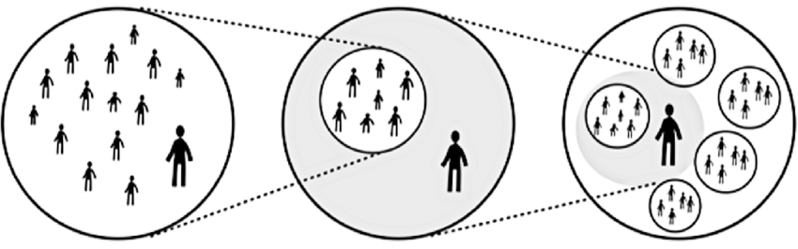
Self-Authoring and Self-Transforming

Slide 9
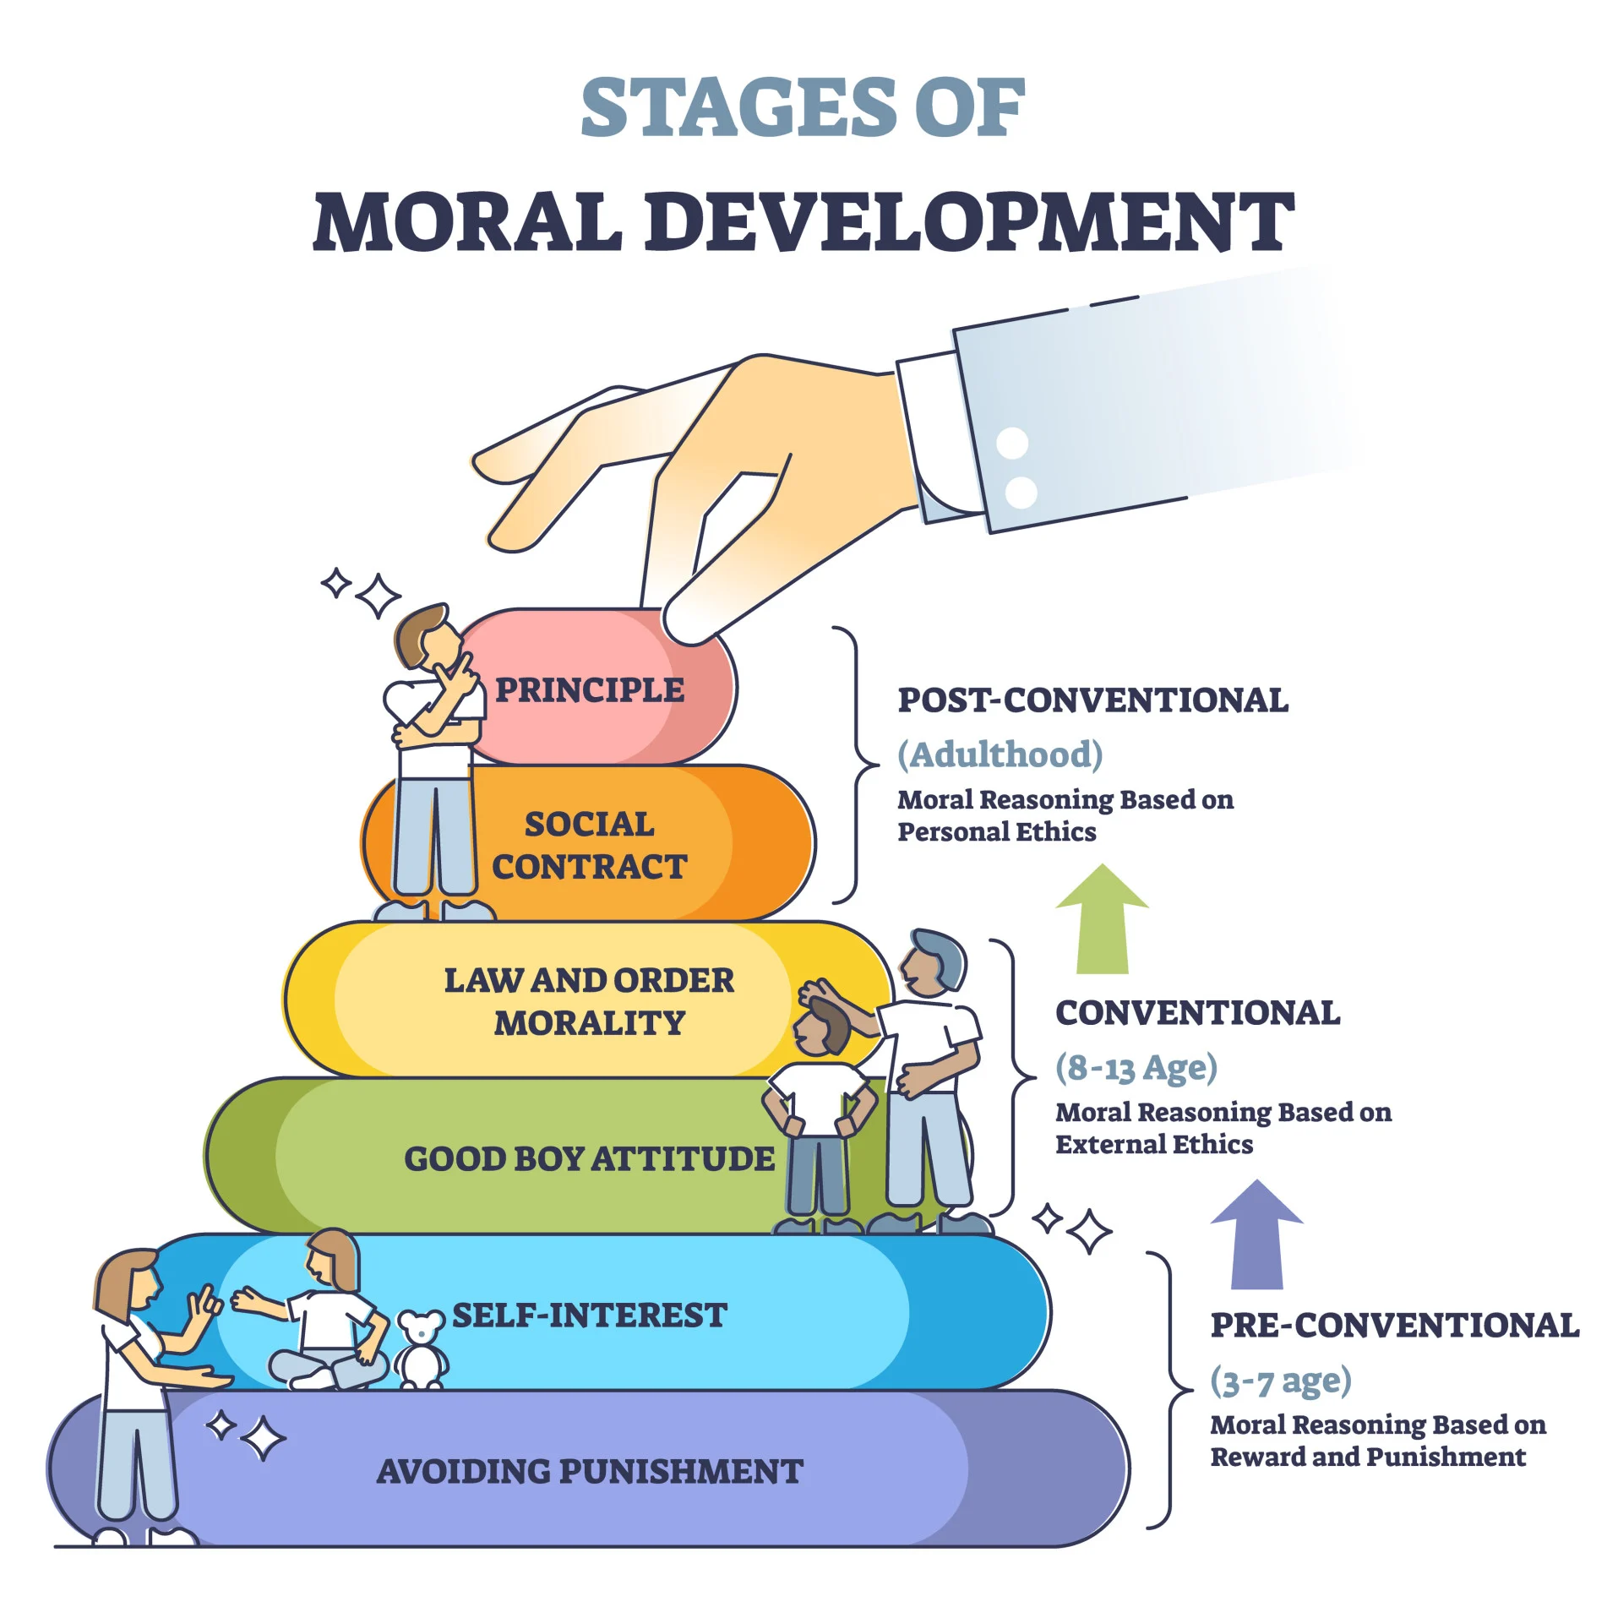
Moral Development

Slide 10
Social Contract
Social Contract: An implicit or explicit agreement among members of a society to cooperate for mutual benefit, often involving negotiation and compromise to balance individual and collective needs, wants, values, and rights. Some features of Social Contract:
Consensus: social contracts work towards consensus through negotiation
Narrative: consensus is achieved through narratives and stories
Belief: people have to believe in the social contract for it to work
Universal Principles: The social contract must appeal to universal principles
Zeitgeist: Social contract is embedded in and constructed with the zeitgeist

Slide 11
Kegan's Theory & Utopian Principles
Self-Authoring Mind: Individuals develop internal values and beliefs, acting independently and navigating complex societal structures.
Self-Transforming Mind: Embrace complexity, contradiction, and interconnectedness, recognizing the continuous evolution of understanding.
Individual Liberty: Autonomy to pursue personal interests, acknowledging diverse paths within a shared framework.
Social Mobility: Opportunities for growth and movement, fostering a culture of equal opportunity.
Standard of Living: A universal goal aligning with foundational human needs and well-being.
Outcome: A society encouraging self-authoring and self-transforming minds, providing a robust foundation while allowing flexibility and diversity, where individuals actively shape their lives within the complex community.

Slide 12

Long Story Short
A society with a Social Contract based on:
Individual Liberty
Social Mobility
Standard of Living
Will create the best environment to support universal human needs:
Basic Needs
Love and Belonging
Autonomy and Freedom
Growth and Self-Actualization
Well-Being

Slide 13
How do we get there?

Slide 14

General Strategy
Initiate Conversation: Engage people in dialogue about these universal principles. Explore agreement, objections, likes, and dislikes to craft organic narratives. Negotiate and compromise.
Research and Messaging: Encourage academics, politicians, and communicators to dissect, discuss, and name these ideas, creating a robust intellectual framework. Teach it, understand it.
Incorporate into Culture: Urge creators, influencers, and storytellers to weave these principles into their works and missions, recognizing the power of timely ideas and compelling stories.
Spread and Embed: Allow the idea to resonate, spread, and become part of the zeitgeist. Naturally, champions will emerge, and it will influence policy and societal norms.

Slide 15

Cautions
Don't put the cart before the horse. There's a correct order of things here. You can't force an organic narrative anymore than you can change wind and tide. You have to go with the flow.
Ends don't justify means. Some of the worst atrocities in humanity were because someone had an idealized view of society and humanity and used brute force to try and make it happen.
Progress is not linear. Systemic change requires systemic efforts, and patience. Grassroots movements always feel glacial, but they can take years or decades to pick up steam, and then the change happens all at once. Be ready for narrative and counter-narrative.

Slide 16

Introducing The Fair Deal
A New Social Contract: A fresh vision inspired by the Square Deal and New Deal, capturing contemporary values and understanding for a more just future.
Based on Core Principles: Grounded in high individual liberty, social mobility, and standard of living; informed by psychological theories of universal human needs.
Global Nonpartisan Initiative: An inclusive, nonpartisan effort to shape a new social contract, inviting diverse contributions. Aimed not just at America, but the entirety of humanity.
Building Consensus: A commitment to gradual, thoughtful change, nurturing consensus across political, economic, social, cultural, and intellectual spheres.

